Slide 1


AP BIO
TOPIC 8.7:
Disruptions in Ecosystems

Slide 2
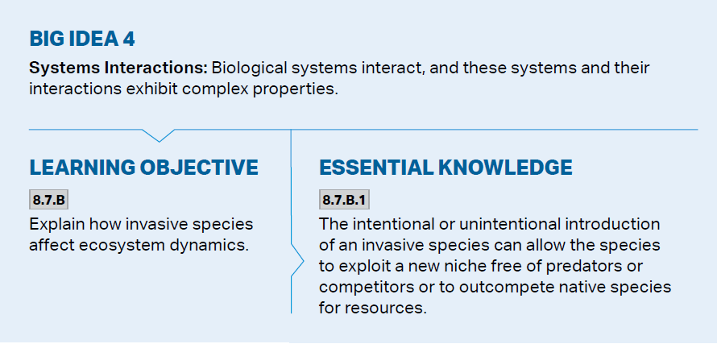
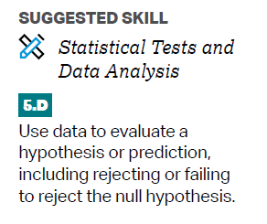
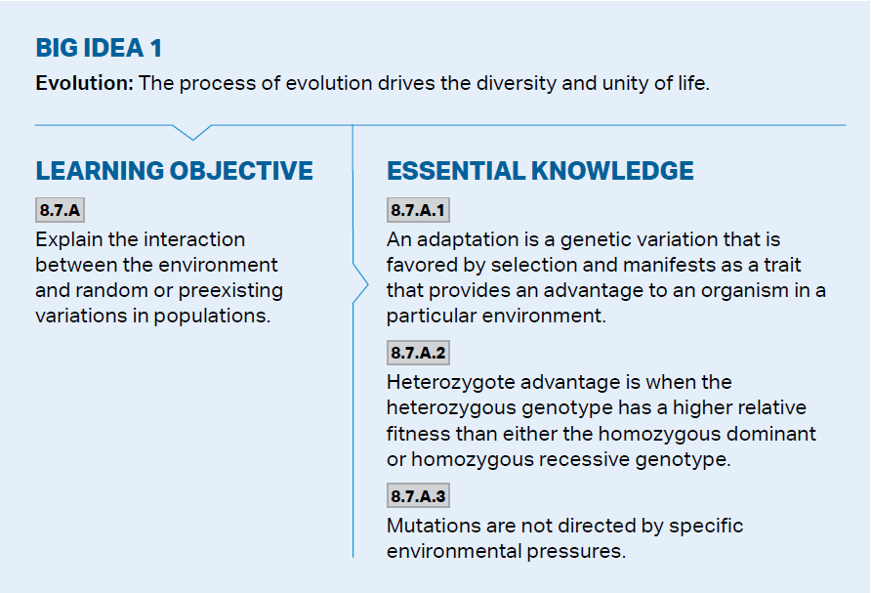
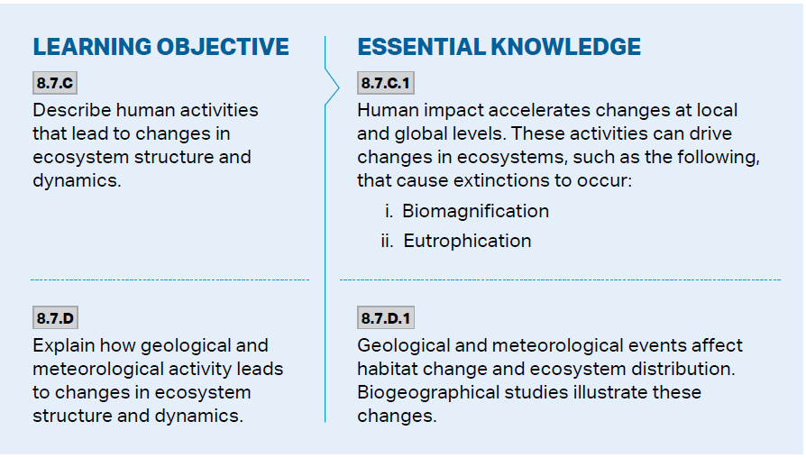
Objectives

Slide 3
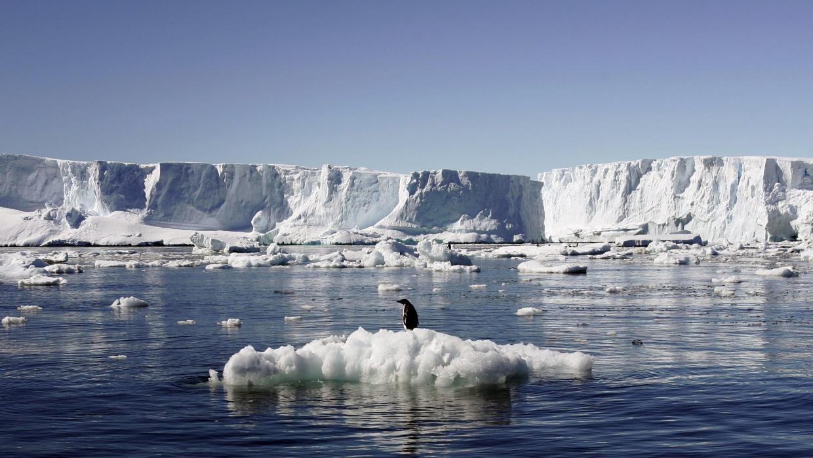
Ecosystems and Adaptations
There are variations in populations (both random and preexisting)
Adaptations – a genetic variation favored by selection, provides an advantage to an organism
Mutations are random but can be beneficial to an organism in an environment
Organisms are generally well adapted to their environments but can be at risk if the environment suddenly changes
Natural changes and human driven changes

Slide 4
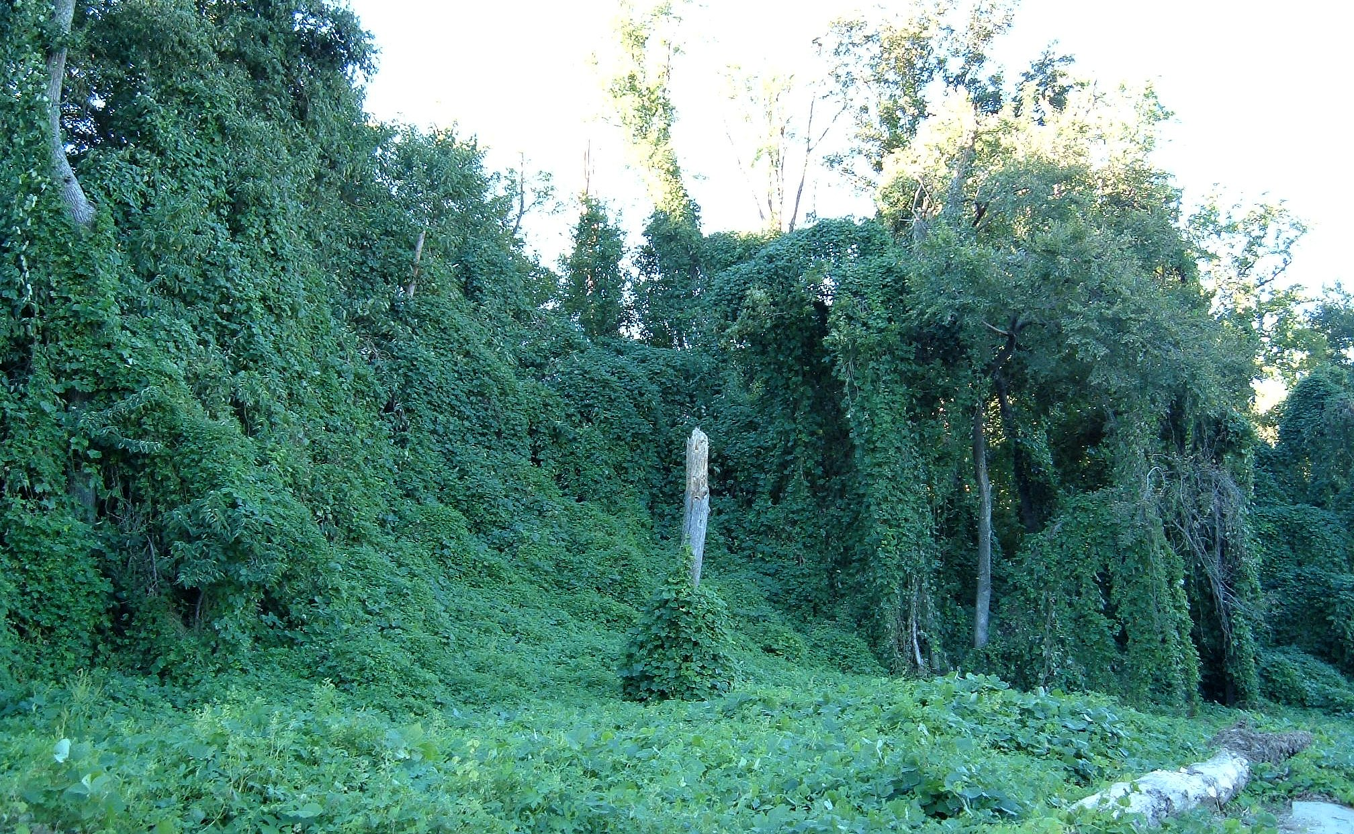
Invasive Species
Invasive species - non-native plants, animals, or pathogens that, when introduced to a new environment usually cause harm to the environment
Exploit new niche – free from predators or able to outcompete native species
Intentional and nonintentional introduction to environments
Notes:
Kudzu, scientifically known as Pueraria montana, is a fast-growing, invasive vine native to East Asia, and has become a significant problem in the Southeastern United States. It was introduced to the US in the late 19th century for erosion control and as a forage crop, but its rapid growth and ability to smother other vegetation have made it a major ecological and agricultural pest.

Slide 5
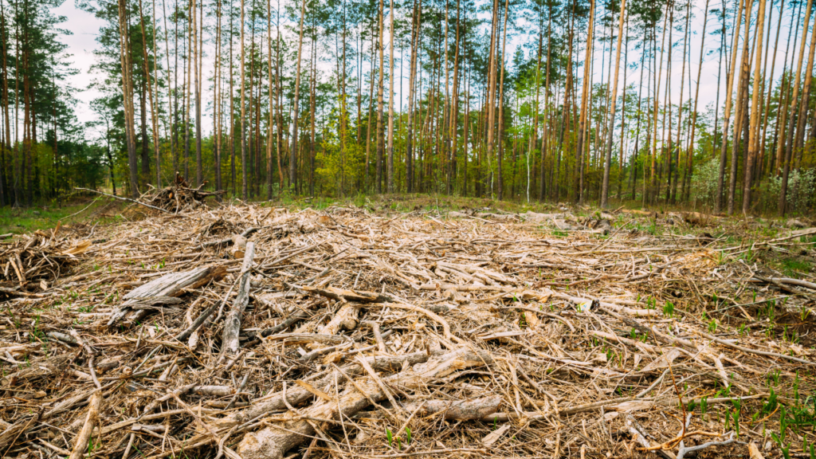
Habitat Loss
Habitat loss – mostly due to human activity – habitats are destroyed -> replaced by monocultures
Low biodiversity = ecosystem is at risk
Logging
Urbanization
Monocropping
Habitat fragmentation – breaks up gene pools, lowers diversity

Slide 6
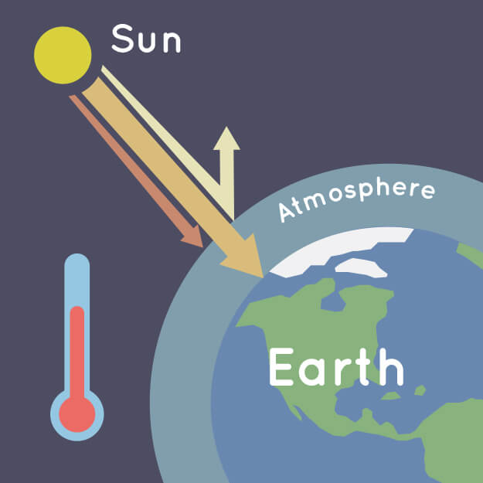
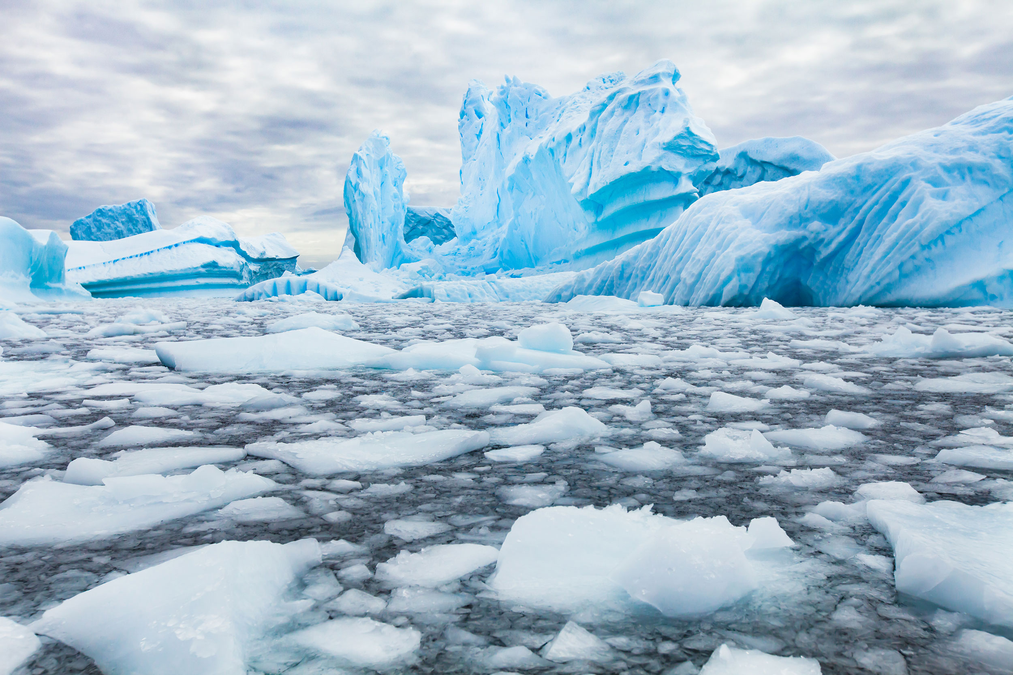
Climate Change
Global climate change – directional change in the global climate (warming), largely due to human activity releasing greenhouse gases into the atmosphere
Leads to further habitat loss, changes in temperature, changes in soil composition

Slide 7
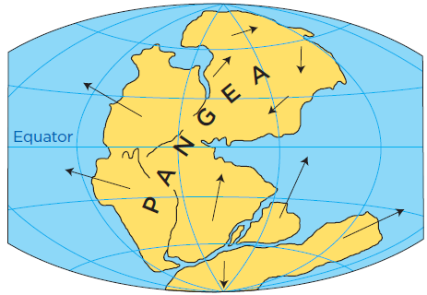
Geological and Meteorological Events
Geological and meteorological events affect habitat distribution
El Nino – changing weather pattern
Continental Drift – affects climate and species distribution
Meteor impact on dinosaurs

Slide 8
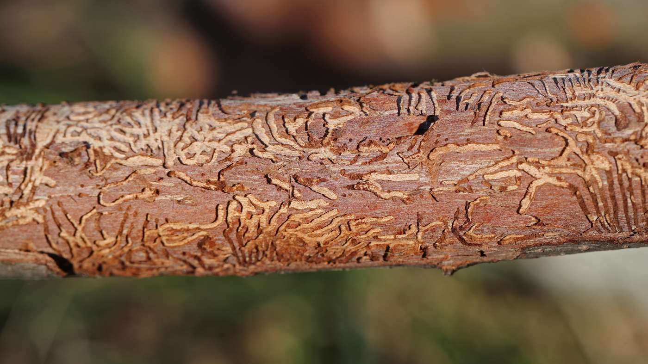
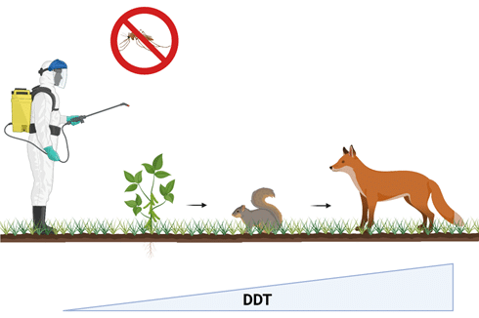
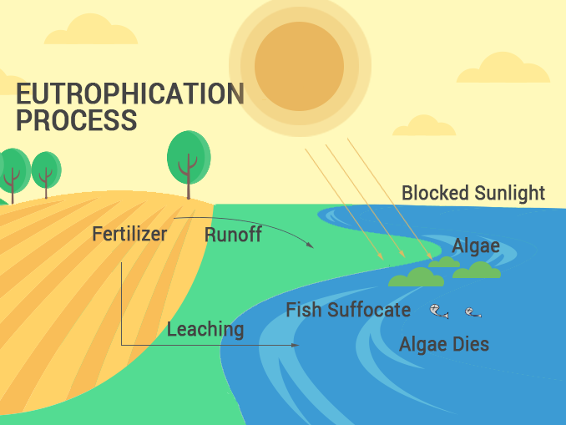
Extinction
Human activities can cause extinction and disrupt ecosystems
Transmission of infection across the Atlantic by humans has resulted in Dutch Elm Disease in America and the Potato Blight in Europe
Biomagnification – toxins that cannot be broken down biologically become more concentrated in successive trophic levels (DDT)
Eutrophication - water bodies become excessively enriched with nutrients leading to harmful algal blooms and oxygen depletion, harming aquatic life (accelerated by agricultural runoff)

Slide 9
Disruptions in Ecosystems Review
Organisms are adapted to their environments
Invasive species, habitat loss, climate change
Humans can cause extinction (biomagnification, eutrophication)
Geological and meteorological events

